Slide 1
What Is Linux ?
Operating System
Eg:-
Like Windows --Microsoft
Mac -------Apple
Solaris----- Oracle

Slide 2
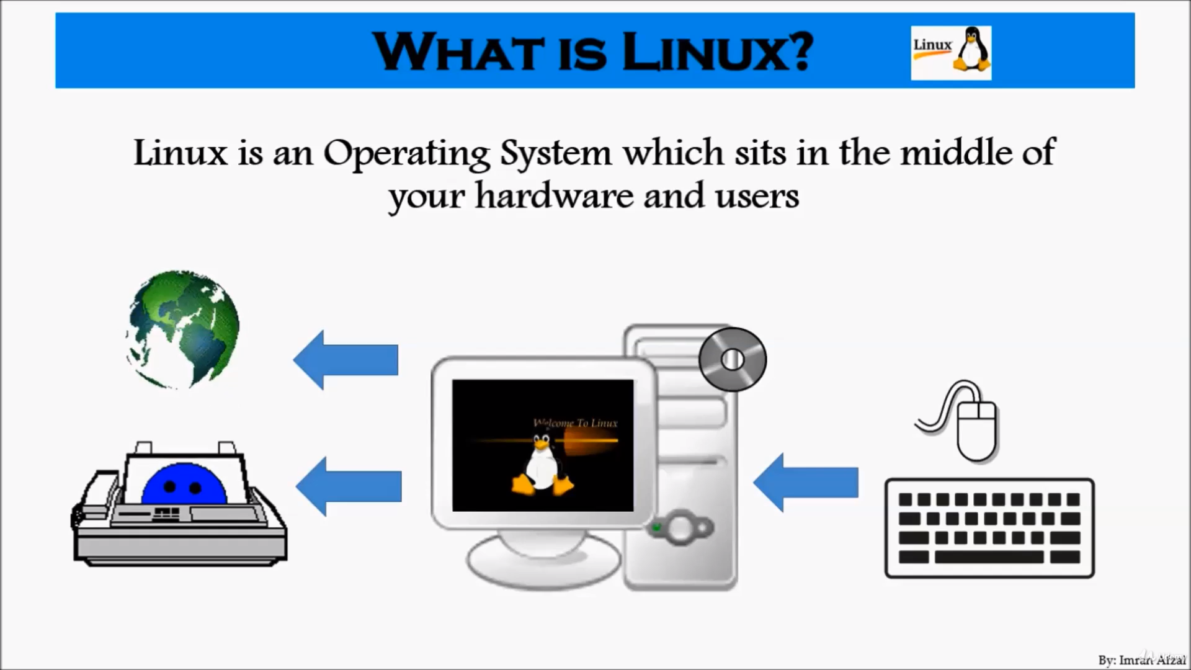
What Is Linux ?

